Slide 1
MIS-Viva_2
And here your subtitle.

Slide 2
TEAM-11 BATCH-A
TEAM MEMBERS
VIKHYAT BANSAL[CB.EN.U4AIE21076]
VIGNESH M [CB.EN.U4AIE21075]
YARRAM SRI SATHWIK REDDY [CB.EN.U4AIE21077]
MARREDDY MOHIT SASANK REDDY[CB.EN.U4AIE21031]

Slide 3
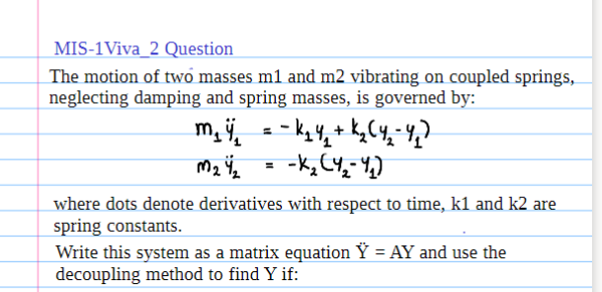
01

Slide 4
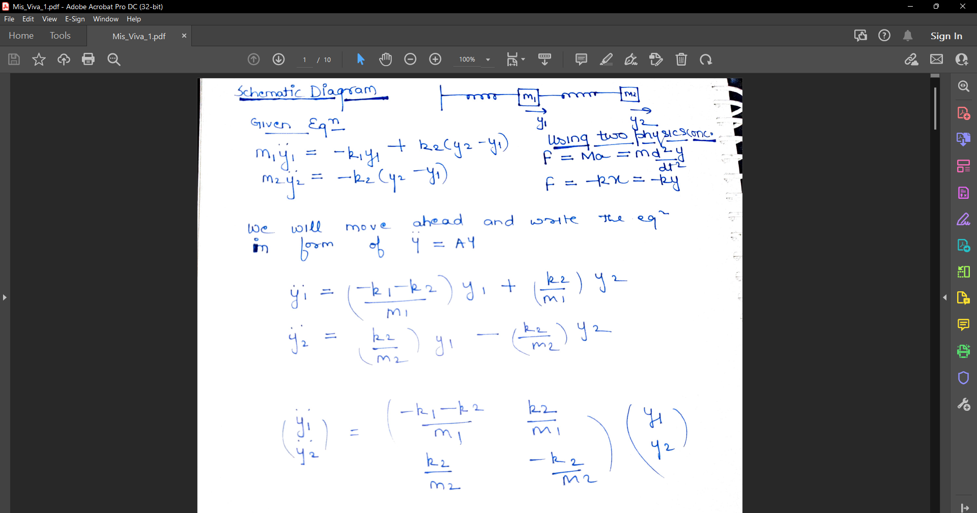

Slide 5
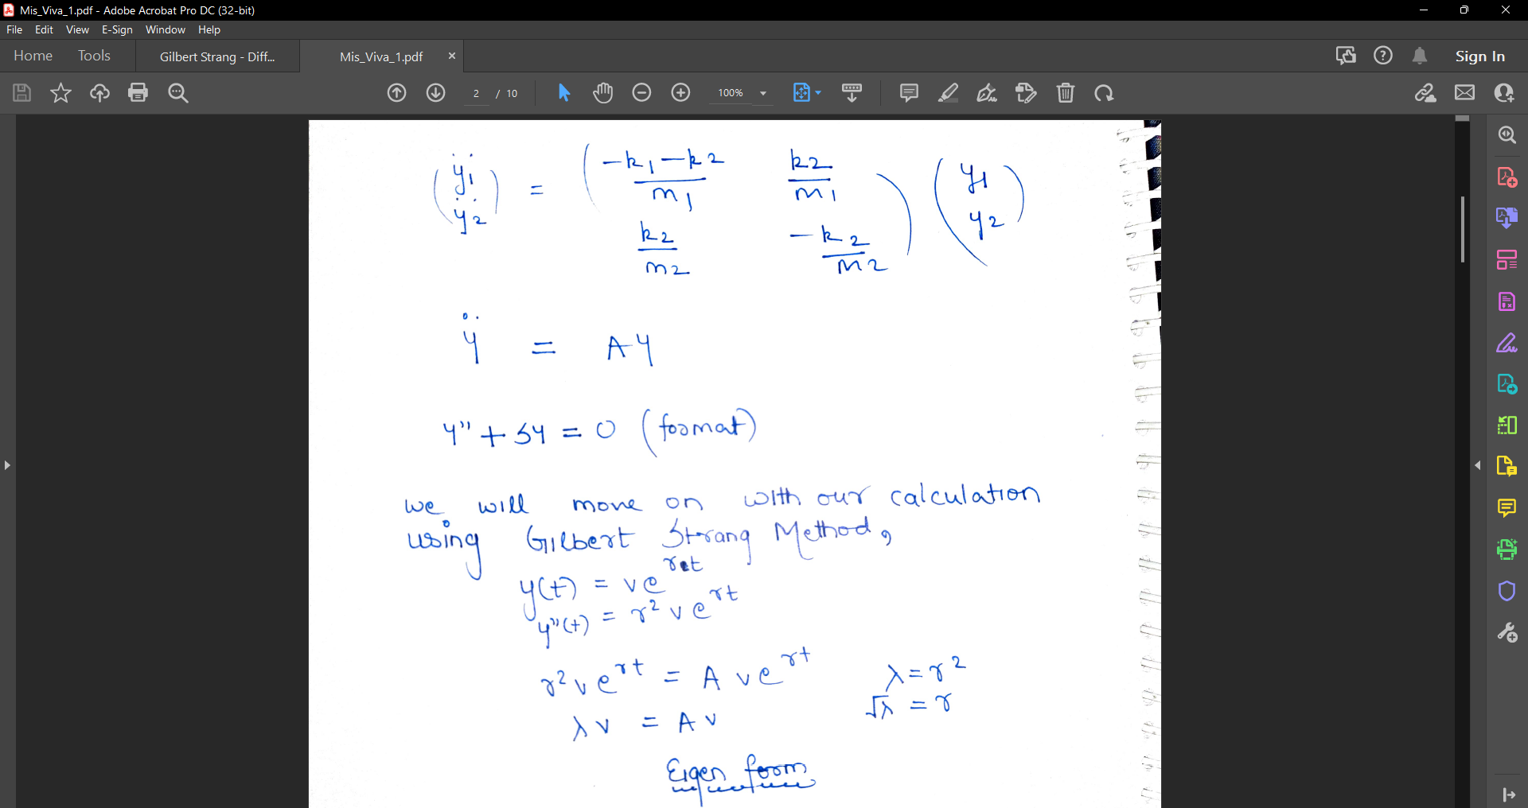

Slide 7
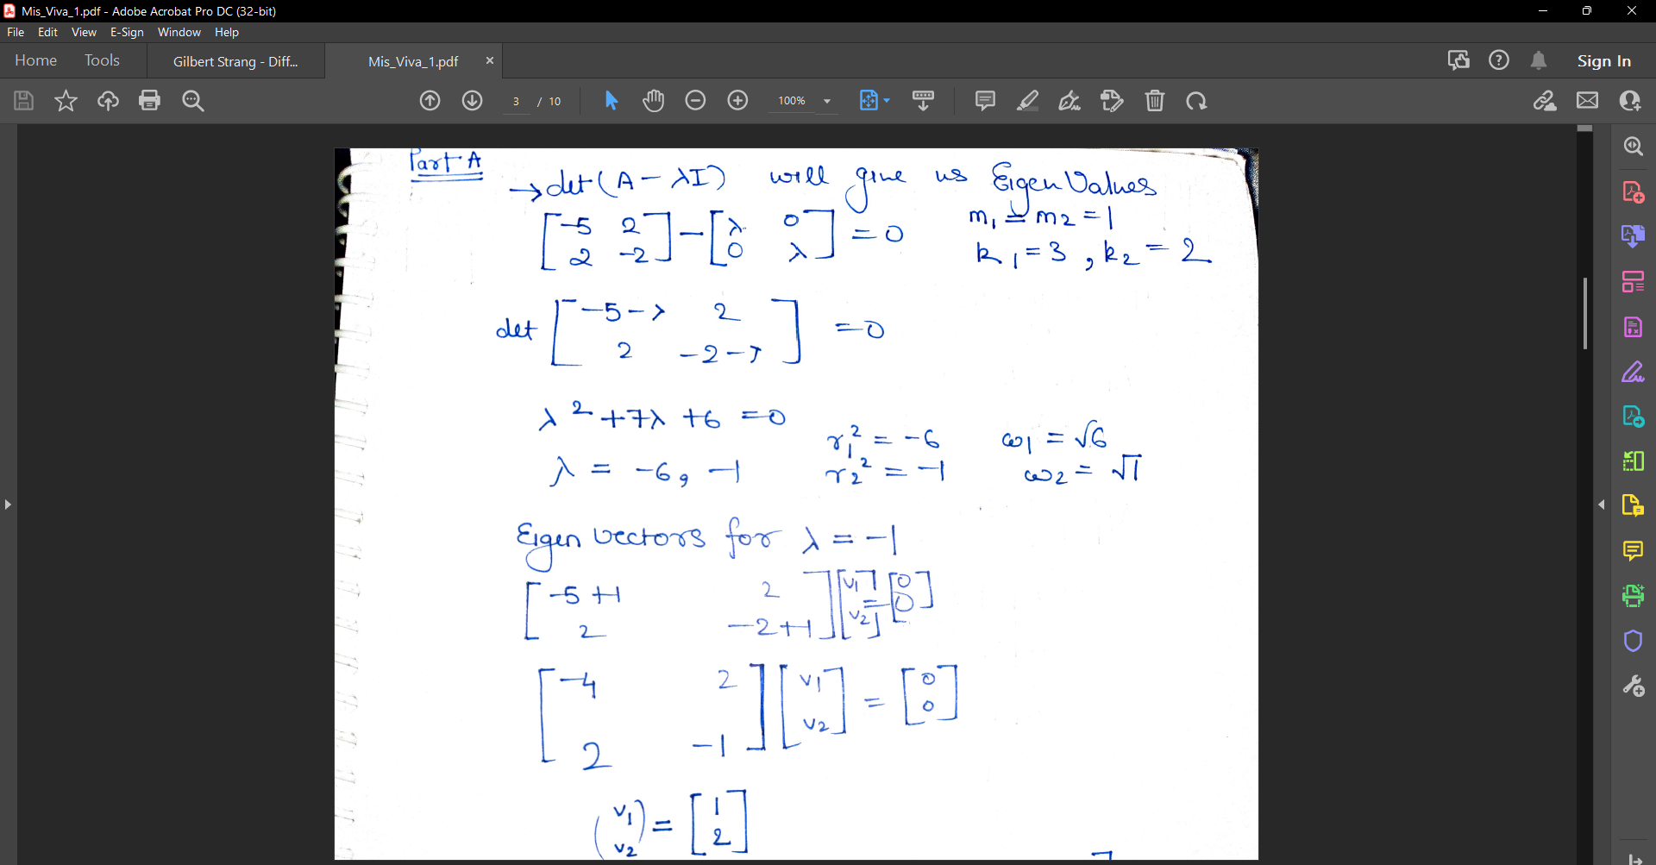

Slide 8
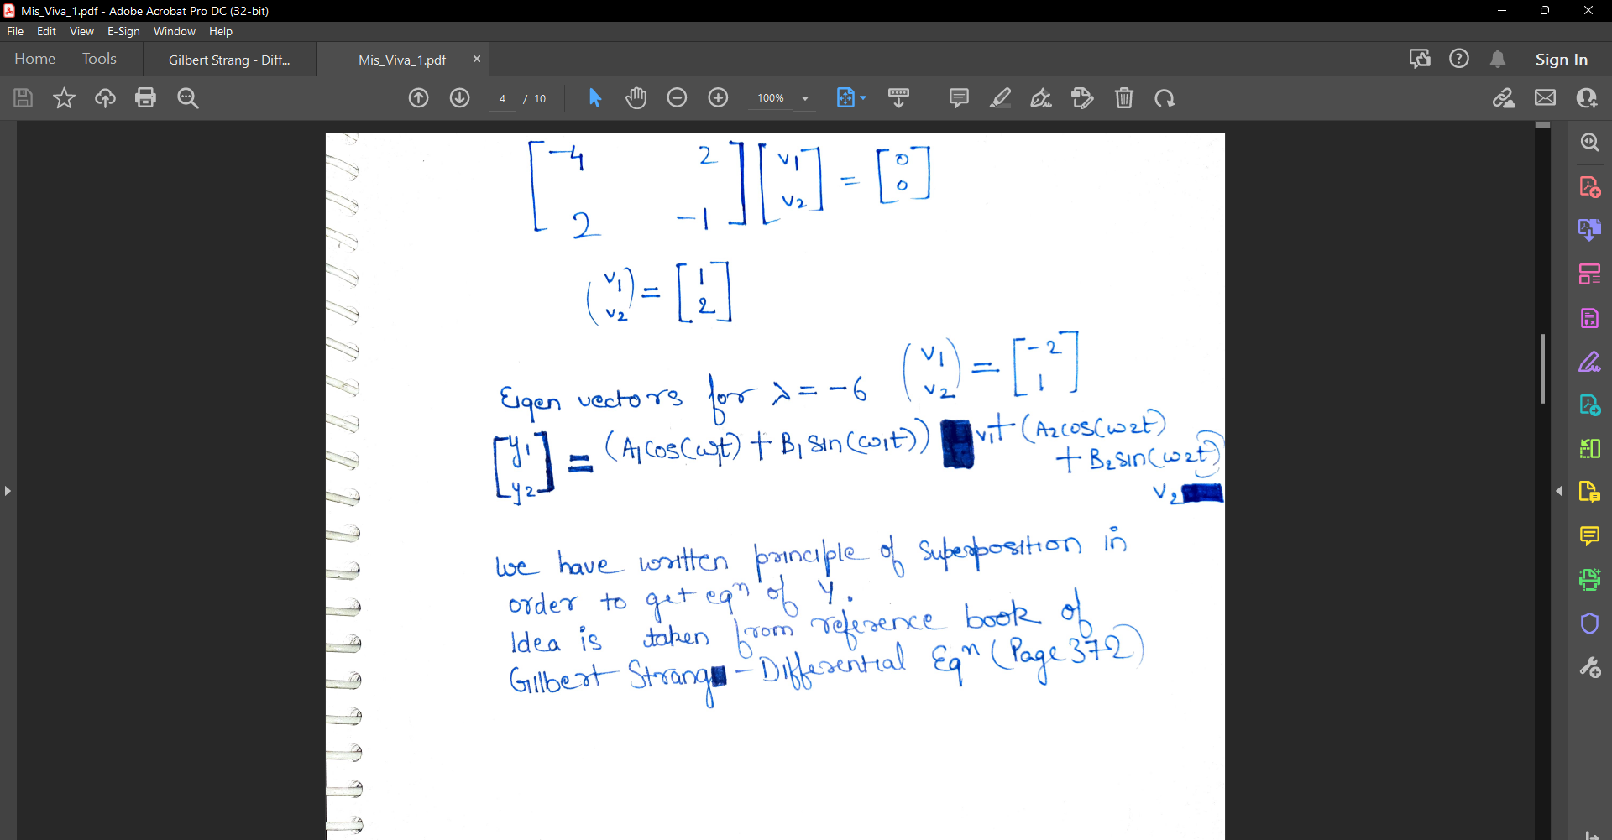

Slide 9
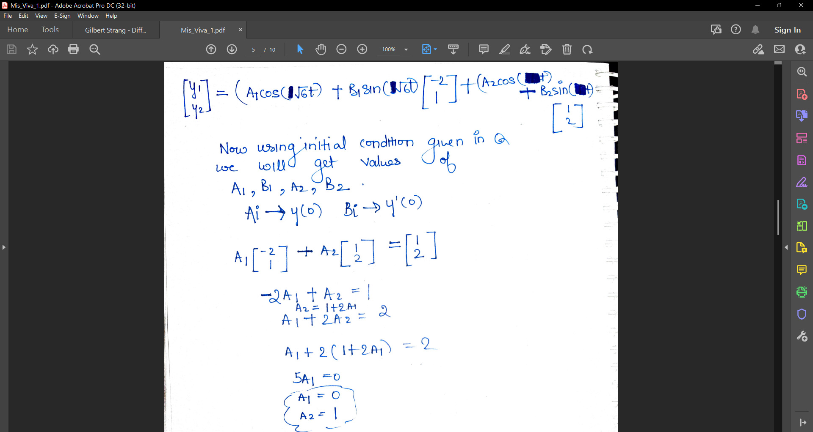

Slide 10
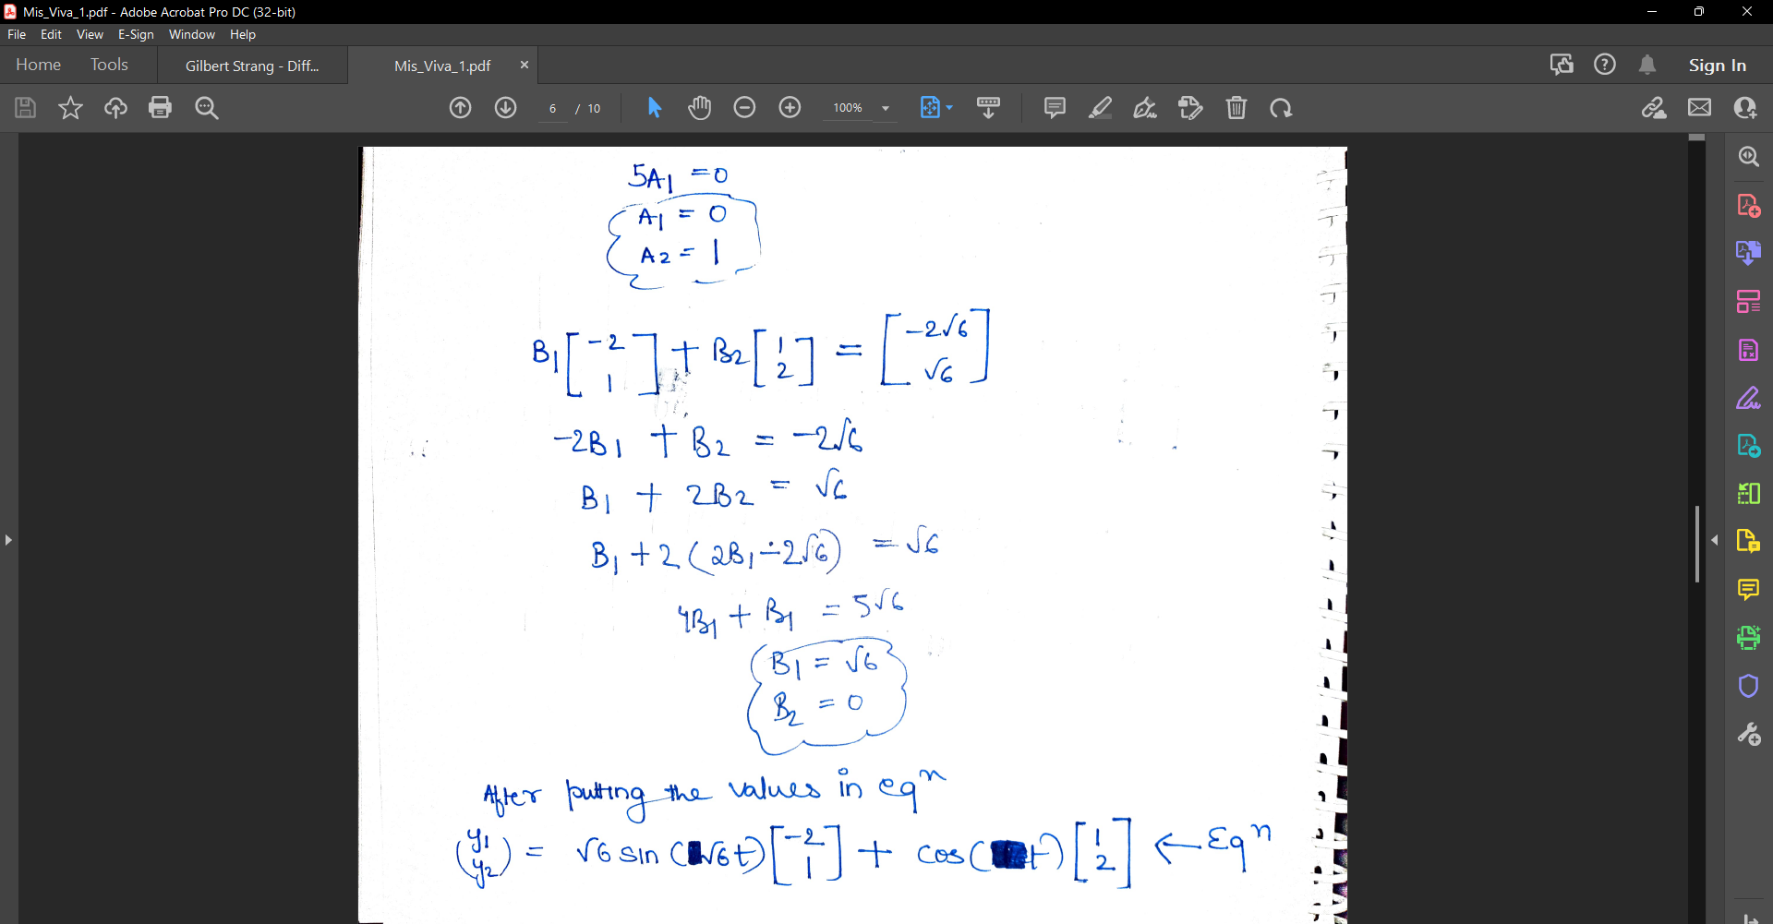

Slide 11
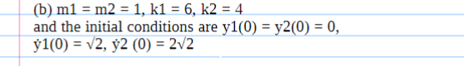

Slide 12
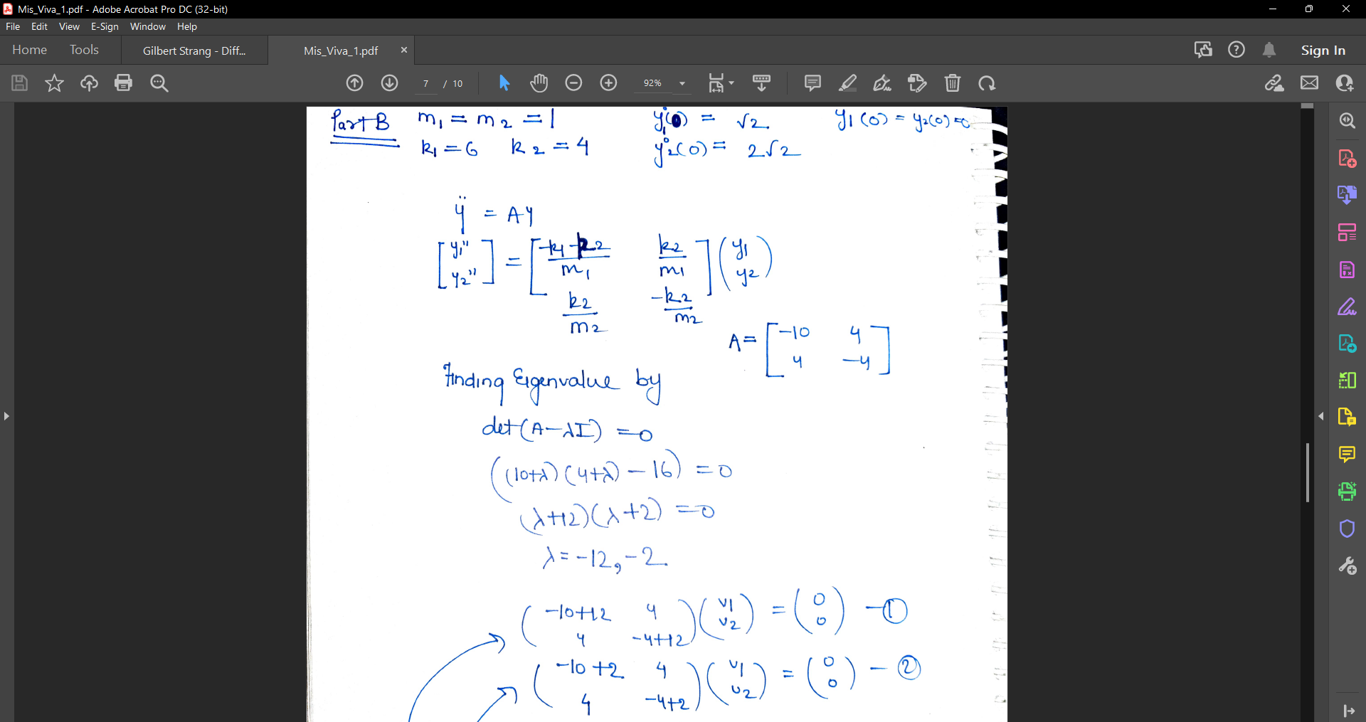

Slide 13
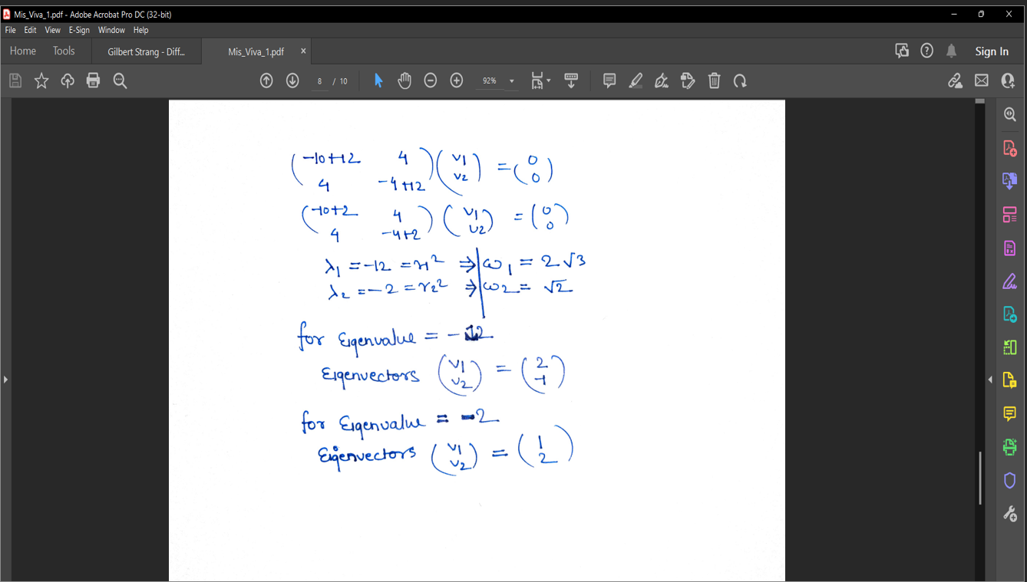
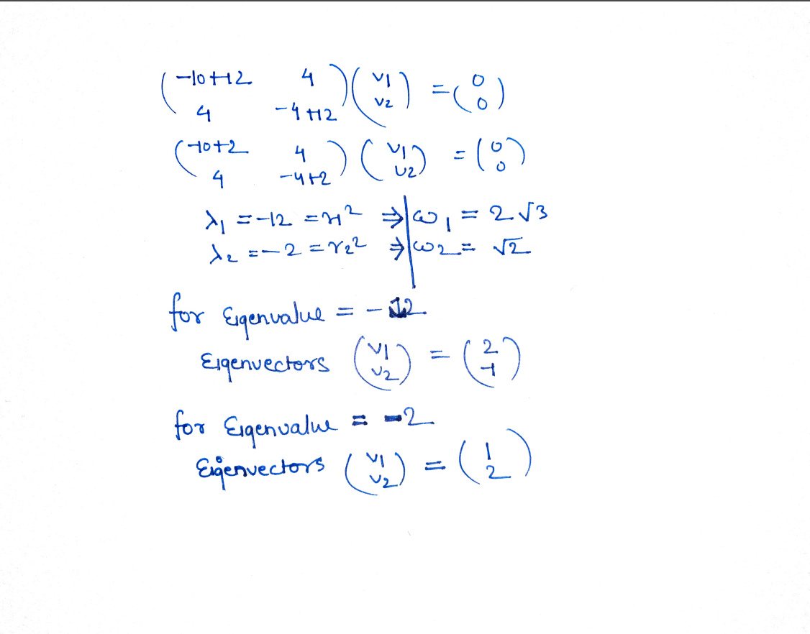

Slide 14
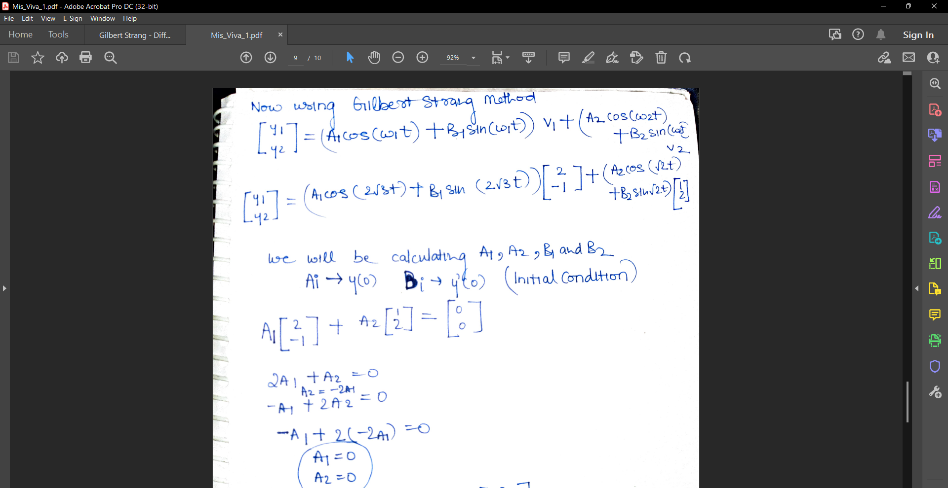

Slide 15
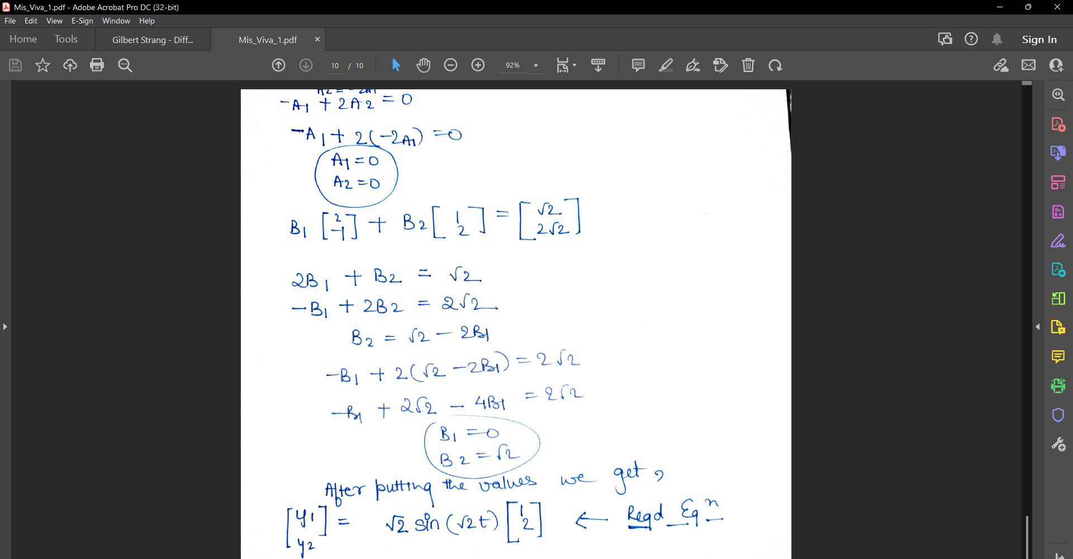

Slide 16
Thank you!

